Slide 1
Supply Chain Analysis

Slide 2
Data Overview
Dataset Summary :
Product Type: Categories such as skincare,haircare and cosmetics.
SKU: Unique product identification codes.
Price: Product prices in relevant currency.
Availability: Product stock status (available or out of stock).
Sales Data: Number of products sold, revenue generated.
Inventory Metrics: Stock levels and lead times.
Order Details: Quantities, shipping times, carriers, and costs.
Supplier Information: Names, locations, and lead times.
Manufacturing Data: Production volumes, costs, and lead times.
Quality Control: Inspection results and defect rates.
Logistics: Transportation modes, routes, and associated costs.

Slide 3
Goals
1 . Optimize Supply Chain Efficiency: Enhance operations by identifying bottlenecks and reducing lead times.
2 . Improve Customer Satisfaction: Ensure timely deliveries and maintain product availability.
3. Minimize Costs: Analyze and reduce manufacturing, shipping, and inventory expenses.
4. Data-Driven Decision Making: Leverage insights from Power BI dashboards for data-driven decision-making.

Slide 4
Tools Used in the Project
SQL
Used to extract data from the team’s database for analysis.
Power BI
Used to create interactive dashboards and visualizations for better insights into profit trends. Power BI helped in visualizing sales performance, expenses, and operational efficiency across various business segments.

Slide 5
Analysis Results
Total Revenue: $55.57 - Despite the modest revenue, opportunities for growth can be identified through efficient stock management and strategic pricing.
Number of Products Sold: 4,276
- High product sales volume highlights strong customer engagement, which can be leveraged to improve revenue through cross-selling and upselling strategies.
Average Shipping Cost: $5 - Competitive shipping costs suggest a well-managed logistics system, but further optimization could increase profitability.
Top Product Category
The most sold product category is Cosmetics, contributing significantly to overall sales.

Slide 6
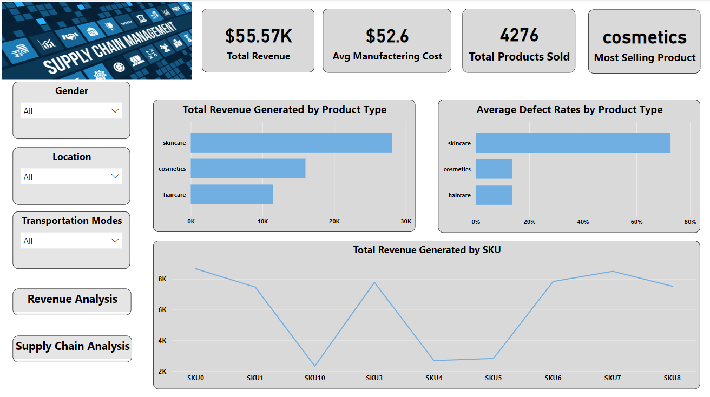
Power BI Dashboard:
Page 1: Overview/Executive Summary
Purpose: Provides a high-level summary of the supply chain performance.
Visualizations Used:
- KPI Cards: Metrics like Total Revenue, Avg manufacturing cost, Total Products Sold, and Most Selling Product.
- Bar Chart: Breakdown of revenue or Defects rates by product categories.
- Line Chart: Total revenue acc to Stock Keeping Unit
Key Insights:
- A snapshot of the business's overall performance.

Slide 7
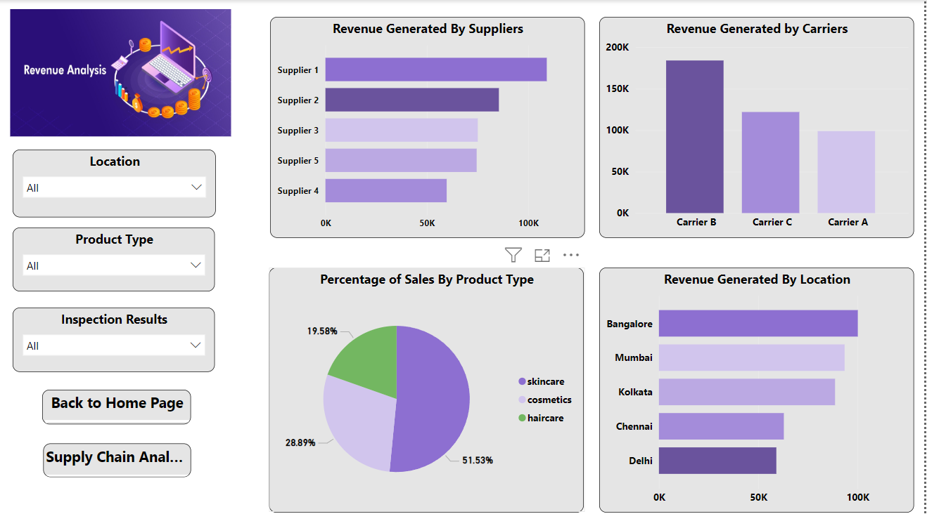
Power BI Dashboard:
Page 2: Revenue Analysis
Purpose: Focuses on detailed insights about revenue and sales percentage.
Visualizations Used:
- Bar Chart: Revenue generated by suppliers and location.
- Column Chart: Revenue Generated by carriers.
- Pie Chart: percentage of sales by individual products.
Key Insights:
Identifies revenue distribution and performance across suppliers, carriers, locations, and product types.

Slide 8
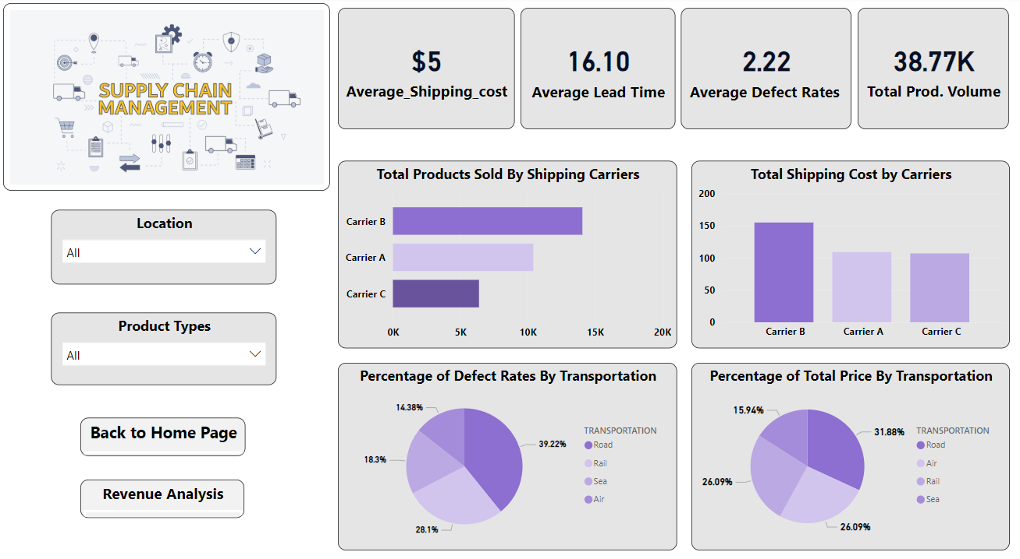
Power BI Dashboard:
Page 3: Shipping and Supply Chain Efficiency
Purpose: Highlights shipping costs, defect rates, and transportation efficiency.
Visualizations:
- Bar charts: Products sold and shipping costs by carriers.
- Pie charts: Defect rates and total price by transportation modes.
Key Insights:
- Carrier B has the highest shipping cost and product volume.
-Road transportation shows the highest defect rates.

Slide 9
Insights
Most Profitable Product Type: Cosmetics generate the highest revenue among product types. Focusing on promoting and optimizing the supply chain for this category could increase profitability.
High Defect Rates in Skincare: Skincare products show a significantly higher defect rate compared to cosmetics and haircare. Investigating manufacturing or quality control processes in this segment is critical.
Top Revenue-Generating Locations: Cities like Bangalore and Delhi contribute the most revenue. Expanding marketing efforts and inventory for these locations can help maximize sales.
Effective Suppliers: Supplier 1 contributes the highest revenue among suppliers. Strengthening partnerships with Supplier 1 and analyzing their processes could improve supply chain efficiency.
Carrier Performance: Carrier B generates the highest revenue and handles a significant portion of products sold. Ensuring Carrier B's operations remain efficient is important for sustaining supply chain performance.

Slide 10
Insights
Cost vs. Transportation: Air transportation incurs the highest cost but may have lower defect rates. A balance between cost and defect management can improve operational efficiency.
Sales by Product Type: Cosmetics represent over 50% of total sales. Prioritizing cosmetics in marketing and supply chain planning will yield better outcomes.
Shipping Costs and Lead Time: The average shipping cost is $5, and the lead time is 16.1 days. Optimizing these metrics, especially for high-demand locations, can improve customer satisfaction and profitability.
Revenue by Product SKU: Revenue trends vary significantly by SKU, with certain SKUs outperforming others. Identifying high-performing SKUs and focusing production on them can drive revenue growth.
Defect Rates by Transportation: Road and rail transportation have higher defect rates compared to air. Investing in better packaging or exploring alternative carriers for these modes can reduce defect-related losses.

Slide 11
Suggestions:
Optimize Carrier B's high shipping costs while maintaining product volume.
Reduce defect rates, especially for road and rail transportation.
Strengthen partnerships with top suppliers like Supplier 1.
Focus marketing and inventory in key locations like Bangalore and Delhi.
Prioritize cosmetics (highest revenue generator) and improve skincare quality.
Leverage dashboards for ongoing monitoring and improvements.

Slide 12
Conclusion:
The analysis reveals significant opportunities for optimizing supply chain operations through targeted strategies.
Prioritizing high-revenue products like cosmetics, improving quality control for skincare, addressing high shipping costs with Carrier B, and focusing on top-performing locations like Bangalore and Delhi can enhance overall profitability and customer satisfaction.
Investments in better packaging and alternative transportation modes can also minimize defect rates and ensure smoother operations.
Leveraging data insights will ensure sustained supply chain efficiency and growth.

Slide 13
Thank You

